Slide 1
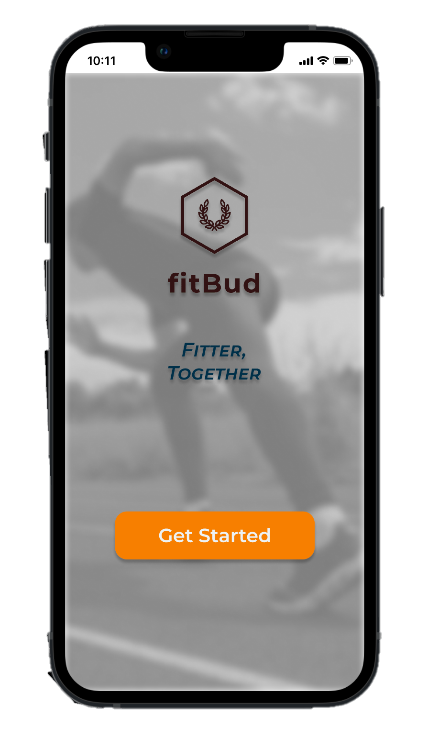
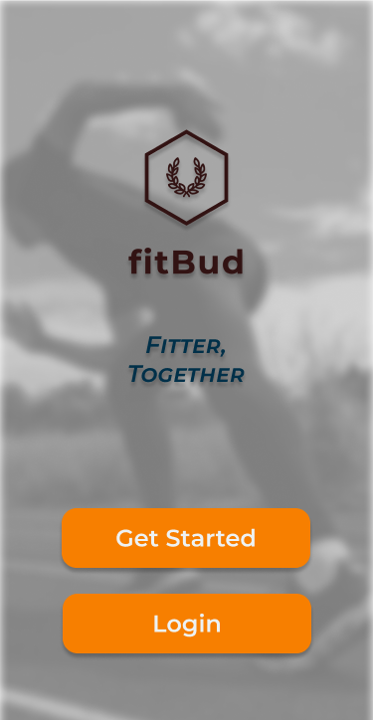

FitBud
FITTER TOGETHER
SAMMY
Summit | Aaron | Marc | Mingyang | Yu Fei
Notes:
A very good afternoon fellow professor, TA and friends. We are SAMMY and today we’ll be bringing to you FitBuds.

Slide 2

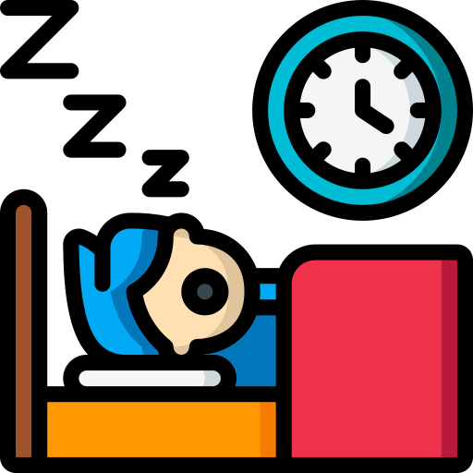


The Problem
7 in 10 NSMen in their 30s fail their IPPT
4 in 10 young adults gaining weight
Why?
Why?
Lack of Motivation
Lazy
Don’t have a plan on how to get started
Unhealthy Lifestyle
Notes:
Let’ start off by understanding the problem at hand. Fitness and health is a concern for many of us. 7 in10 NSMen in 30s are failing their IPPT. Why is this so? This is due to a lack of motivation and the lack of a plan on getting into shape. In addition, 4 in 10 young adults are gaining weight. This is due to them being increasingly lazy and leading unhealthy lifestyle. For those who do not know, IPPT is a fitness that residents of Singapore have to undergo as part of their national service obligations. It consists of push-ups, sit-ups and a 2,4km run.

Slide 3






What is FitBud?
Main Functionalities
FitBud is a one-stop platform and a fitness buddy for NSFs and NSMen to train for their IPPT.
Dedicated Fitness Plan
Pose Detector
Our app aims to curate a personalized fitness plan for the user.
Our app integrates AI to help users detect their posture and help them improve.
Expected Users
Connecting With Friends
Recommend Exercise Location
Our app aims to allow users to connect with other nearby users with similar fitness level so that they have a fitness buddy.
Our app integrates government data sets on parks and gyms to recommend locations for users to train.
NSFs, NSMen and Fitness Enthusiasts
Notes:
We believe that FitBuds can help alleviate this problem. So what is FitBuds? FitBuds is a one-stop fitness platform and buddy for NSFs and NSMen to train for their IPPT. We expect to onboard NSFs, NSMen and Fitness Enthusiasts. We have 4 main functionalities. Firstly, a dedicated fitness plan. Our app would be able to curate a personalized training plan for the user based on their target and current fitness levels. Secondly, an AI enabled pose detector that can feedback to the user on their form and posture. This helps a user to maximize their workouts. Thirdly, a social feature that connects users with other nearby users who have similar fitness level. This serves to find a buddy for the user so that they will be grounded and motivated together. Lastly, a recommend exercise location feature that draws upon open-source government database to recommend users on where they can train.

Slide 4
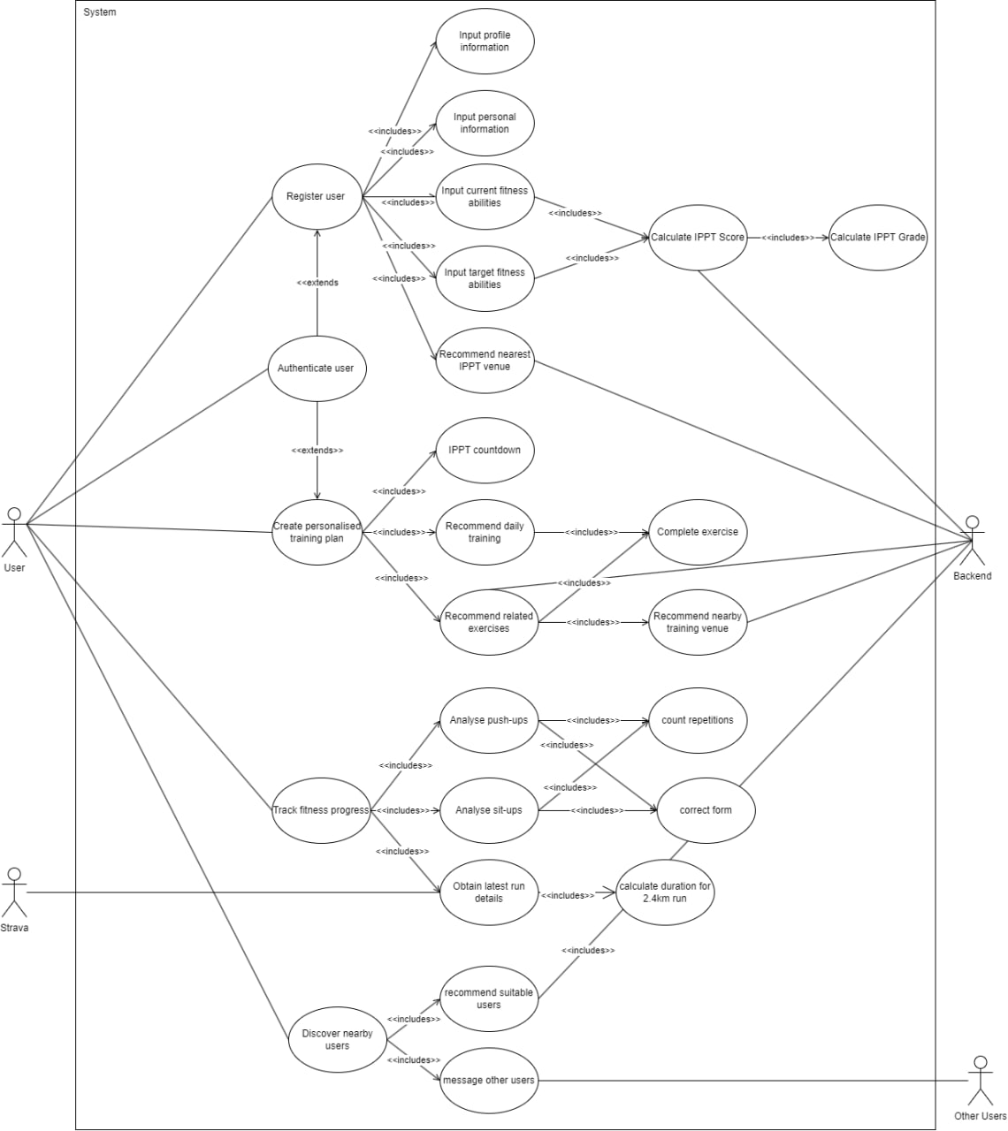
Overview of Use Case Diagram
Main Use Cases
Register User
Authenticate User
To prompt for user information during registration.
To prompt for username and password.
Create Personalized Training Plan
Track Fitness Progress
To create a personalized training plan for the user based on their current and target fitness.
To track user’s push-ups, sit-ups and run timings.
Discover Nearby Users
To connect nearby users with similar IPPT scores and arrange meet-ups for users.
Notes:
As seen, all those features are broken down into various use cases and can be seen in out use case diagram. We have 5 primary use cases: Register User, Authenticate User, Create Personalized Training Plan, Track Fitness Progress and discover nearby users.

Slide 5
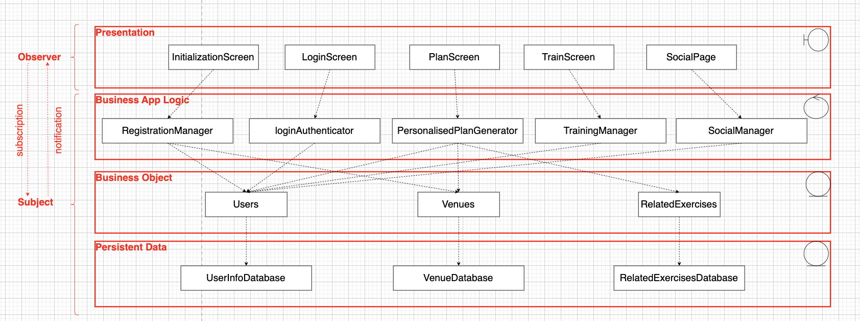
Overview of System Design
Notes:
The culmination of our functional requirements, non-functional requirement, design principles, design patterns and constraints leads us to our system architecture

Slide 6

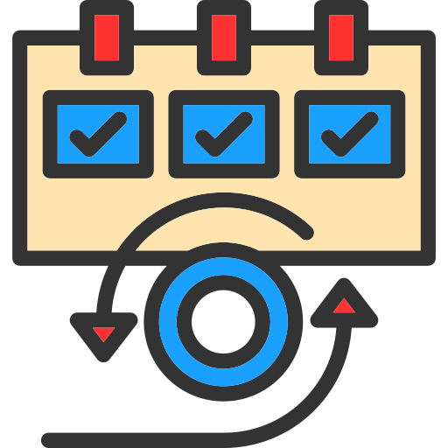

Good Software Practices
SOLID Framework in UML
SCRUM Framework
Testing
Single Responsible Principle
Open-Closed Principle
Liskov’s Substitution Principle
Interface Segregation Principle
Dependency Inversion Principle
Focuses on iterative development
We adopted a 1-week sprint cycle with daily SCRUM meetings and weekly reviews.
White box testing:
Basis path testing
Control flow testing
Black box testing:
Equivalence class testing
Boundary value testing
Achieve loose coupling and high cohesion, resulting in reusability, extensibility and maintainability
Allows efficient delivery of project. Reviews allow to gather feedback and re-optimize methods.
Good mix of black and white box testing allows for comprehensive bugs identification
Notes:
Throughout our entire software engineering process, we have utilized good software engineering processes learnt from our lessons. We utilized the solid framework in our UML modelling. This helps us to ensure that our functions and classes are flexible and easy to maintain and upgrade.
We adopted the SCRUM framework in our development process. We had weekly sprints with daily SCRUM meetings and weekly reviews. This helped us in optimizing our processes which enable an efficient delivery of our project, Another important aspect of having good software practices is robust testing. We achieve this through a mix of Blackbox and Whitebox testing.

Slide 7

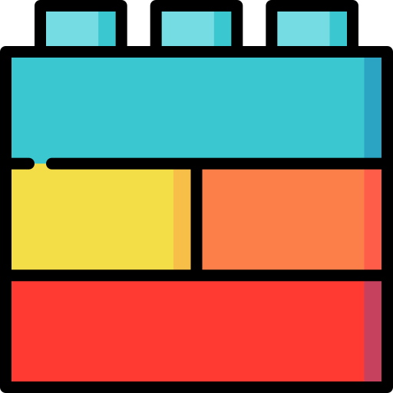
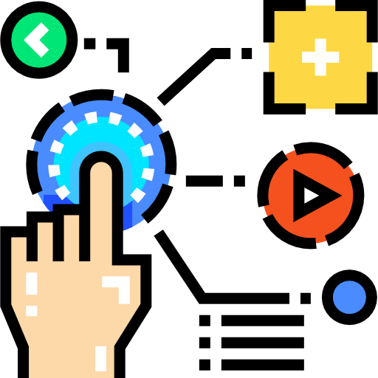
Good Software Practices
Managing Requirements
Component Based Architecture
Control Changes to Software
Continuously reviewing documentations as we go along.
Bringing up discrepancy during SCRUM meetings
Maintaining forward and backward traceability of documents
Adopting a component-based software development
Reusing react-native and custom-built components
Decomposing architecture into subsystems and assigning them
Creating branches for team members to commit to
Essential in quality and process control
Improves maintainability and extensibility of software
Ensures that there is no overlapping of work and previous work done is not affected.
Notes:
Managing Requirements is essential in quality and process control. We achieved this by continually reviewing our documentation, bringing up discrepancy during SCRUM Meetings and maintaining forward and backwards traceability of documents. Next, adopting a component-based architecture was another good practice we adopted. We did by reusing react-native and custom-built components. This improves our maintainability and extensibility of our software. Lastly, it is important to have a mechanism for controlling changes to software. In our case, we decomposed the architecture into subsystems and assigned them to our members. We utilized github in our control mechanism. We created individual branches for our team members to commit to. This ensured that there was no overlapping of current and previous work and that work done is not affected in the event something goes wrong.

Slide 8
How can we support future upgrades?
Having a SOLID framework in our UML reduces dependencies and promotes extensibility. Software can be updated or upgraded without impacting other areas of our code.
Using SCRUM as our methodology allows us to break down our upgrades to smaller pieces. This allows us to build iteratively and efficiently.
Managing documentation is important because it allows us to find gaps within our software. This aids us in our upgrades.
A component-based architecture allows us to stack components on one another. This makes implementation efficient and simpler.
Notes:
Good software practices allows us to support future upgrades. In our case, having a SOLID framework in our UML reduces dependencies and promotes extensibility. Software can be updated or upgraded without impacting other areas of our code.
Using SCRUM as our methodology allows us to break down our upgrades to smaller pieces. This allows us to build iteratively and efficiently.
Managing documentation is important because it allows us to find gaps within our software. This aids us in our upgrades.
A component-based architecture allows us to stack components on one another. This makes implementation efficient and simpler.

Slide 9






Tech Stack
Frontend
Backend
Cloud service
Notes:
Before we dive into our implementation, here is our tech stack. We used React Native for our frontend UI development. TensorFlow for our computer vision model. The backend is implemented and managed using nodeJS, mongoDB and expressJS. Our application runs using cloud which is hosted on AWS.

Slide 10
Data Sets
FCC Conditioning Centres
IPPT in your community
Gyms@SG
ExRx.net
IPPT scoring chart
Notes:
We have used the following data sets in our app. FCC Conditioning centers, Gyms@SG and IPPT in your community is obtained using Data.gov.sg, a government database. Our exercise database is built using ExRx.net and IPPT Scoring chart is obtained from the internet.

Slide 11
Live Demonstration
Notes:
Now we will be moving onto our live demonstration. Legend: underline refers to the actions to do. Sequence of action.
Register new user
username: Summit
password: ilovesc2006
name: Summit Bajaj
address: 639798
dob: 1 april 2000
current: 50, 50, 720
target: 60, 60, 600
Redirected to plan page
Number of days to IPPT
Test Location
Daily Training
Daily training– complete each daily training
Click the redirect
Click back
Bonus exercises
Mark them as complete
Navigate to social page
List of nearby users
Click xiao ming to chat function
Navigate to profile page
User details including age, current grade and ippt test date
Navigate to train page
Click on 2.4km run
Authenticate with Strava
Click on pushups
Perform pushups (good & bad form)
Submit data

Slide 12
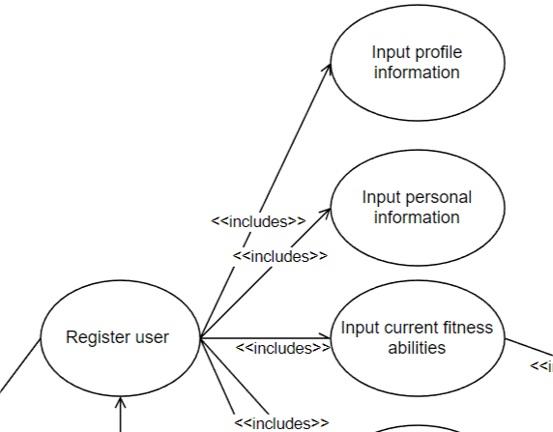
Traceability of Input Profile Information
Use Case
Use Case Diagram
Functional Requirement:
The app must prompt for the user’s login information.
The app must prompt for the user’s username, which must have at least one character.
The app must prompt for the user’s account password which length must be at least 8, have at least 1 letter, have at least 1 number and must not contain the user’s username.
Notes:
Now that we have seen the demonstration, lets explore the traceability of FitBud’s Input Profile Information. The functional requirements are that a user must be able to key in a valid username and password. The corresponding use case diagram can be seen.

Slide 13
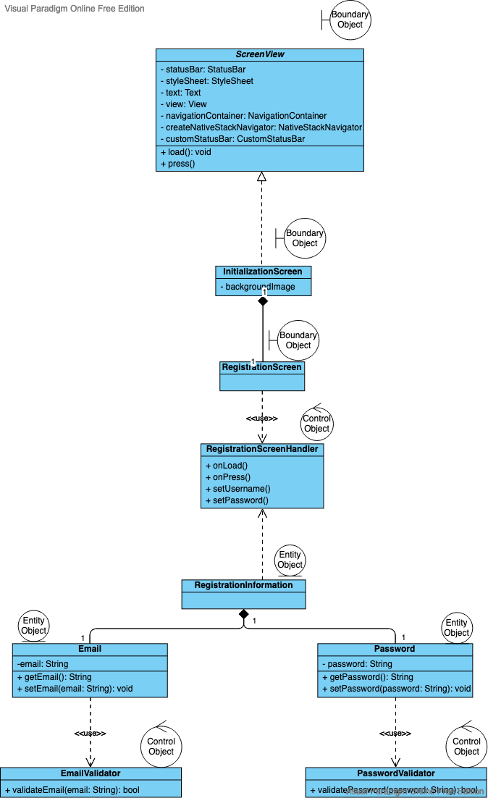
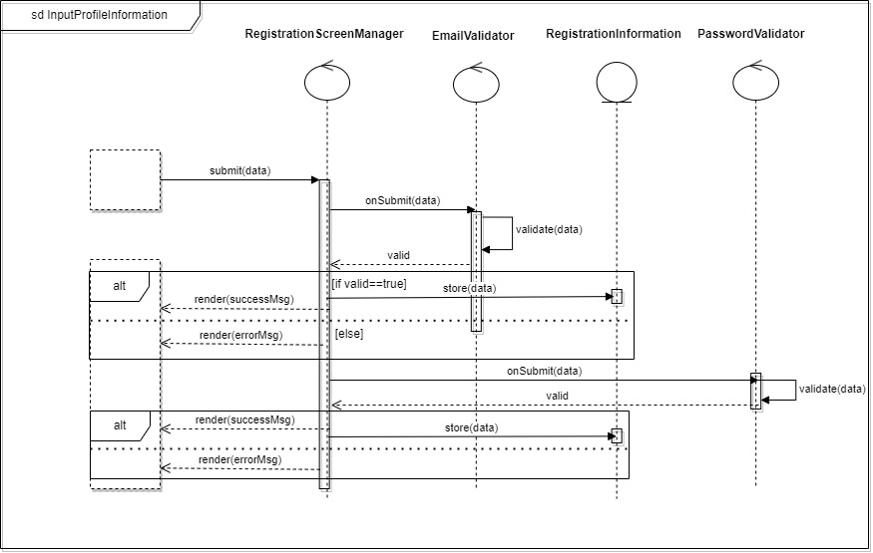
Class Diagram
Sequence Diagram
Notes:
From this, we develop our sequence diagram, as seen. Using that we develop our class diagram. We can see how the use case and sequence diagram come together to form the class diagram with the different boundary, entity and control objects.

Slide 14
Good Design Principles
Single Responsibility Principle
Each of the classes has a specific responsibility. This improves the changeability of the code, with simple and independent units interacting through well defined interfaces
The validator is specific to this use case
Open-Closed Principle
RegistrationInformation class is open for extension, but is closed for modification. If there are new registration information required (eg. NRIC number), it is possible to add new registration information without modifying the code in the RegistrationInformation class
Liskov Substitution Principle
RegistrationScreenHandler implements the ScreenHandler class. As the RegistrationScreenHandler child has the same pre- and post- conditions as the ScreenHandler parent, it is able to substitute for the parent
Notes:
We have implemented the solid framework in our use case.
Single Responsibility Principle
Each of the classes has a specific responsibility. This improves the changeability of the code, with simple and independent units interacting through well defined interfaces
The validator is specific to this use case
Open-Closed Principle
RegistrationInformation class is open for extension, but is closed for modification. If there are new registration information required (eg. NRIC number), it is possible to add new registration information without modifying the code in the RegistrationInformation class
Liskov Substitution Principle
RegistrationScreenHandler implements the ScreenHandler class. As the RegistrationScreenHandler child has the same pre- and post- conditions as the ScreenHandler parent, it is able to substitute for the parent

Slide 15
Good Design Principles
Interface Segregation Principle
Usage of many client specific interfaces instead of one general purpose interface
Classes do not depend on interfaces that they do not use
Dependency Injection Principle
The registration screen is plugged into a framework via the abstract class
Notes:
Interface Segregation Principle
Usage of many client specific interfaces instead of one general purpose interface
Classes do not depend on interfaces that they do not use
Dependency Injection Principle
The registration screen is plugged into a framework via the abstract class

Slide 16
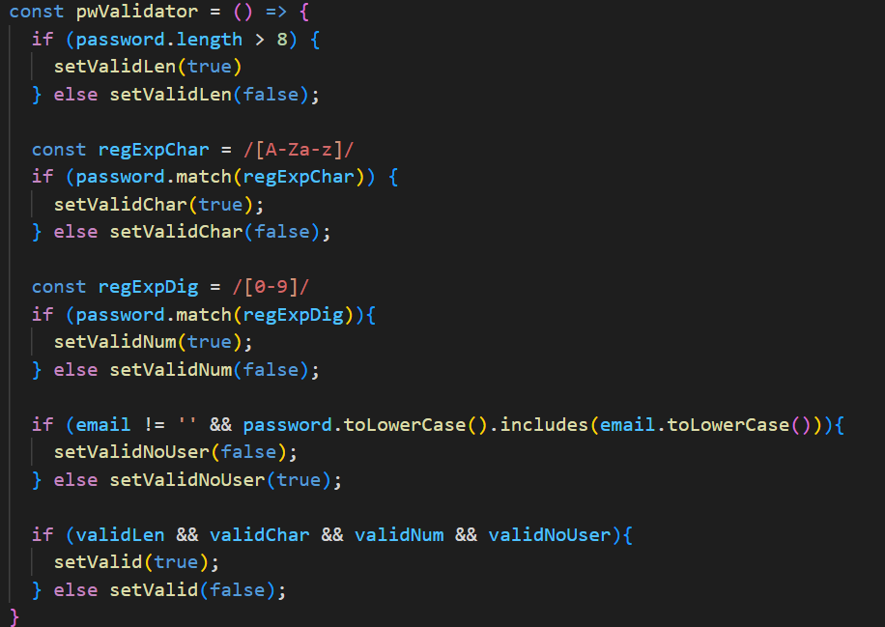
Implementation
Notes:
This is the following implementation in code

Slide 17
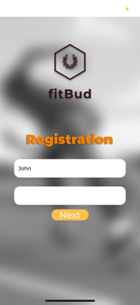
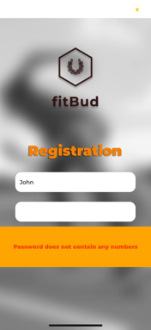


Testing
Test Input | Oracle | Log
Password | Expected Output | Actual Output
ilovesc2006 | No output message, app allows user to proceed
johnlovesc2006 | “Password contains username”, user is not allowed to proceed
Test Input | Oracle | Log
Password | Expected Output | Actual Output
ilovescse | “Password does not contain any numbers”, user is not allowed to proceed.
12345678 | “Password does not contain any characters”, user is not allowed to proceed.
Notes:
Now that we have seen the requirements, development and implementation. Let’s see how it holds through testing. As we see, we do meet our requirements and that inappropriate passwords registers an error.

Slide 18
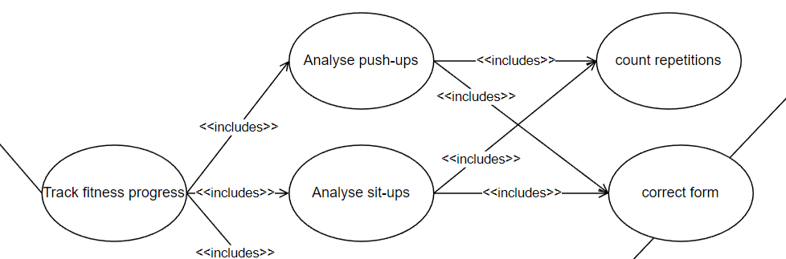
Traceability of Analyze Push-Up/Sit-Up
Use Case
Functional Requirement:
The app must be able to accurately track and correct the user’s push-ups during his attempts.
The app must allow the user to begin an attempt which will start a 60 second timer.
The app must classify the correct push-up form from an incorrect one with an accuracy of 90%.
The app must count the number of correct push-ups performed by the user within the attempt.
The app must display live feedback on the screen to correct the user’s form during the attempt.
The app must have the option for users to submit the results of their attempt to be stored.
The app must have the option for users to redo their attempt as many times as desired.
Use Case Diagram
Notes:
Moving on, we will be looking at the traceability of exciting analyze push-up module. In summary, the requirement is that the app feedbacks the user on the posture of the user’s push up and count correct push-ups.

Slide 19
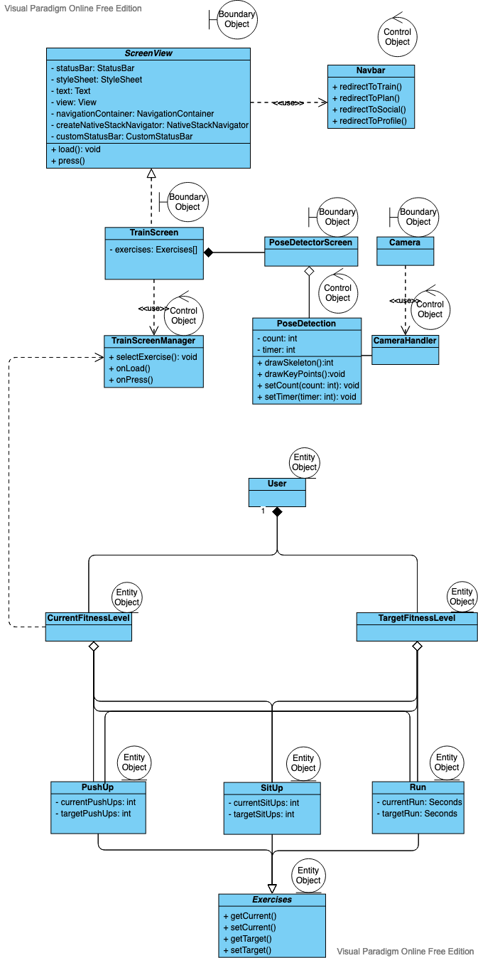
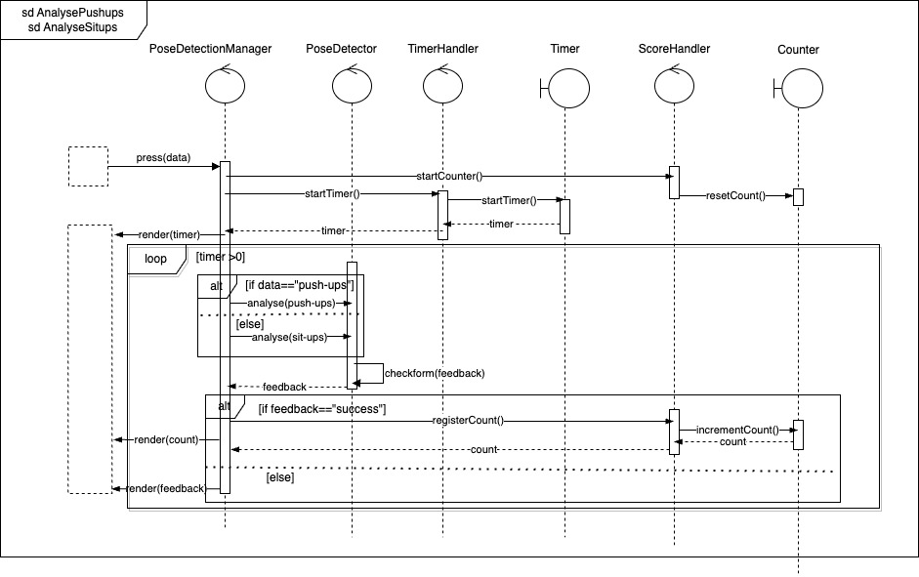
Class Diagram
Sequence Diagram
Notes:
From this, we develop our sequence diagram, as seen. Using that we develop our class diagram. We can see how the use case and sequence diagram come together to form the class diagram with the different boundary, entity and control objects.

Slide 20
Good Design Principles
Single Responsibility Principle
The different components of count repetition, correct form are separated and kept isolated to reduce their complexity and their tendency to be altered .
Open-Closed Principle
The different use cases of count repetition and correct form are kept as separate components in our implementation to encourage extensibility without modifying them.
Pose detection can be extended to be used for tracking of other exercises without the need to change its source code
Liskov Substitution Principle
The 2 use-cases of analyse push-ups and sit-ups implement strategy pattern as they are interchangeable with one another as they implement design by contract
Notes:
Similarly, in this module we have implemented SOLID in our designing of our class diagrams.
Single Responsibility Principle
The different components of count repetition, correct form are separated and kept isolated to reduce their complexity and their tendency to be altered .
Open-Closed Principle
The different use cases of count repetition and correct form are kept as separate components in our implementation to encourage extensibility without modifying them.
Pose detection can be extended to be used for tracking of other exercises without the need to change its source code
Liskov Substitution Principle
The 2 use-cases of analyse push-ups and sit-ups implement strategy pattern as they are interchangeable with one another as they implement design by contract

Slide 21
Good Design Principles
Interface Segregation Principle
Usage of many client specific interfaces instead of one general purpose interface
Classes do not depend on interfaces that they do not use
Dependency Injection Principle
The pose detection module is complex. Thus, it is separated from the count push-up and sit-up through the TrainScreen module.
Notes:
Interface Segregation Principle
Usage of many client specific interfaces instead of one general purpose interface
Classes do not depend on interfaces that they do not use
Dependency Injection Principle
The pose detection module is complex. Thus, it is separated from the count push-up and sit-up through the TrainScreen module.

Slide 22
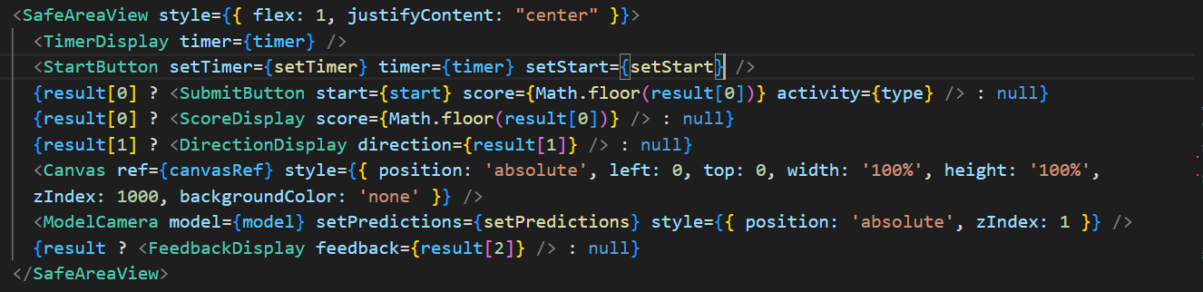
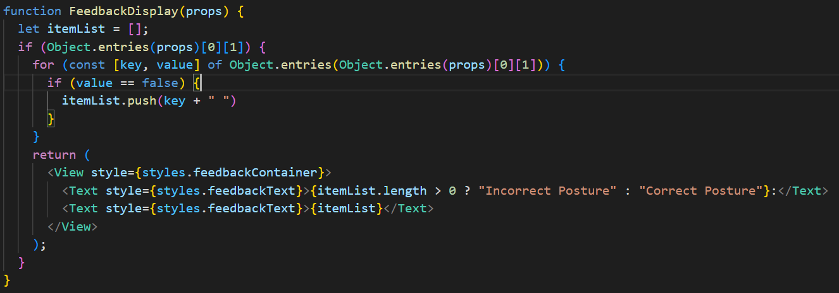
Implementation
Overall Layout
Form correction component:
Notes:
With that here is the implementation. We can see the various segments of code for the different implementations.

Slide 23
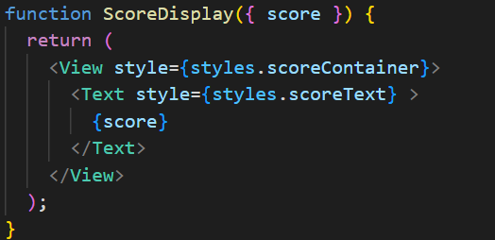
Implementation
Pose detector for push-ups or sit-ups:
Repetition counter component:

Slide 24
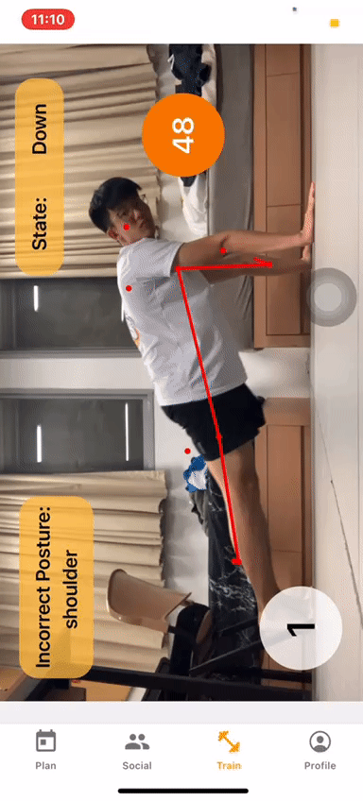
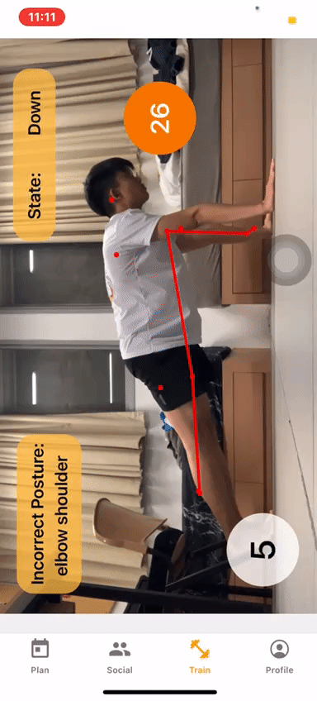
Testing
Successful Push-up Attempt:
Unsuccessful Push-up Attempt:
Notes:
With that, we can see how it holds up with the testing. The app is able to count a successful push up and provide feedback for an unsuccessful one.

Slide 25
Thank You
JOIN US TODAY TO BE FITTER TOGETHER
Notes:
With that we believe that people can get fitter with FitBud with our features. We hope that you join FitBud today to be fitter. Thank you.

